Slide 1







Team Straw Hats
Presentation
Akshay
Lead
Misha
Back end developer
Nandini
Front-end developer
Nanditha
Designer

Slide 2



Are you constantly struggling to find a parking spot for your vehicle ?
Don’t worry we got you covered

Slide 3


Park’N Ride
Revolutionizing parking solving urban parking challenges

Slide 4

Ideation
We enable the users to see the available parking places in their chosen location
We provide additional income to the parking space owners
We use the empty spaces to provide efficient parking spots
We contribute to reduce traffic congestion on unban roads

Slide 5



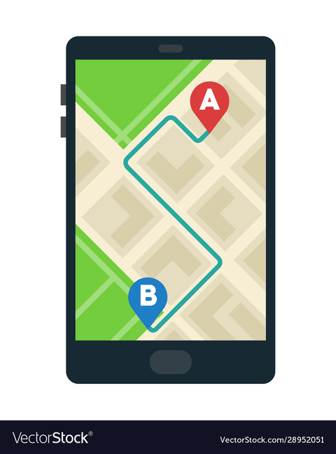
Features
Real time parking
Payment Integration
GPS Navigation
Integration with GPS allows users to easily navigate to their chosen parking spot, minimizing the time spent searching for it
Enable secure, convenient in-app payments for parking reservations. Support various payment methods, including credit/debit cards, digital wallets, and mobile payment solutions.
Users should be able to check real-time availability of parking spaces at various locations, including parking lots, garages, and on-street parking.

Slide 6

Sustainability
Q1
Q2
Q3
Economical sustainability
Social sustainability
Environmental sustainability

Slide 7



Novelity
Dynamic pricing and space untilization
Extra income generation
Real time information

Slide 8

Thank You

